Slide 1


Slide 2
CS302 Design and Analysis of Algorithms Lecture 4: Recursion
Dr. Fahad Sherwani
(Assistant Professor – FAST NUCES)
fahad.sherwani@nu.edu.pk

Slide 3
What is Recursion?
Sometimes, the best way to solve a problem is by solving a smaller version of the exact same problem first
Recursion is a technique that solves a problem by solving a smaller problem of the same type

Slide 4
When you turn this into a program, you end up with functions that call themselves (recursive functions)
int f(int x)
{
int y;
if(x==0)
return 1;
else {
y = 2 * f(x-1);
return y+1;
}
}

Slide 5
How do I write a recursive function?
Determine the size factor
Determine the base case(s)
(the one for which you know the answer)
Determine the general case(s)
(the one where the problem is expressed as a smaller version of itself)
Verify the algorithm
(use the "Three-Question-Method")

Slide 6
Deciding whether to use a recursive solution
When the depth of recursive calls is relatively "shallow"
The recursive version does about the same amount of work as the nonrecursive version
The recursive version is shorter and simpler than the non-recursive solution

Slide 7
Merge Sort
Some Slides from Jerome (McGill University) and Shang-Hua Teng
Students are required to read from Book too

Slide 8
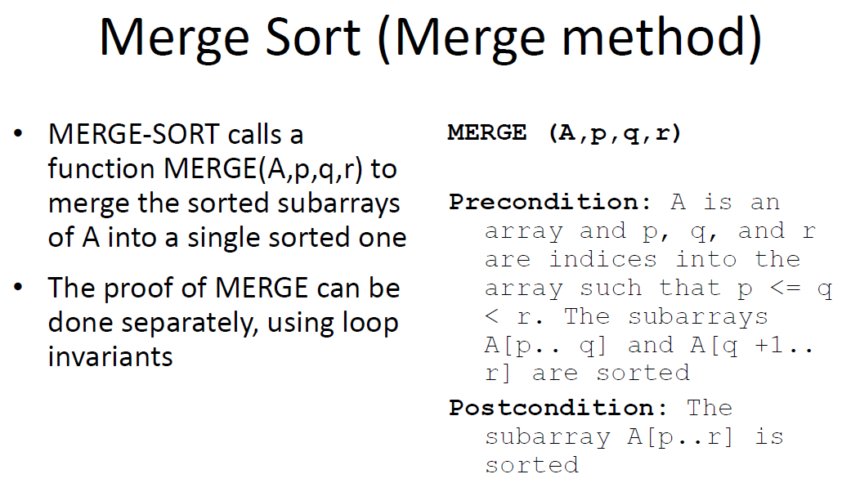

Slide 9
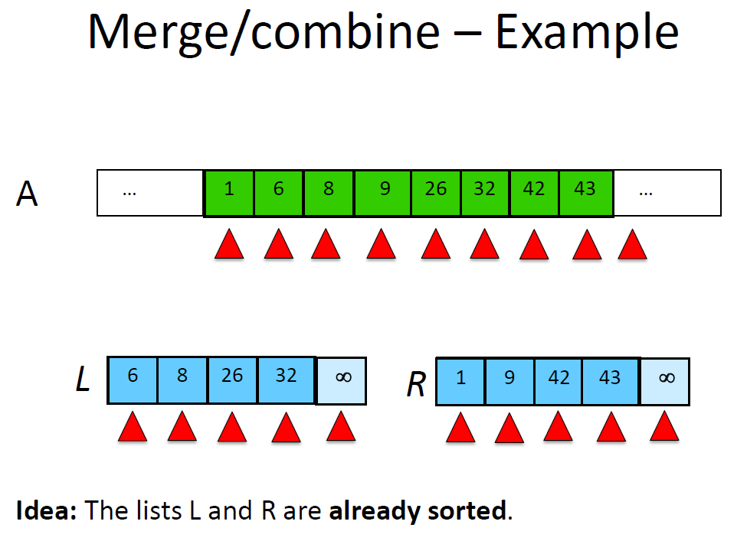

Slide 10
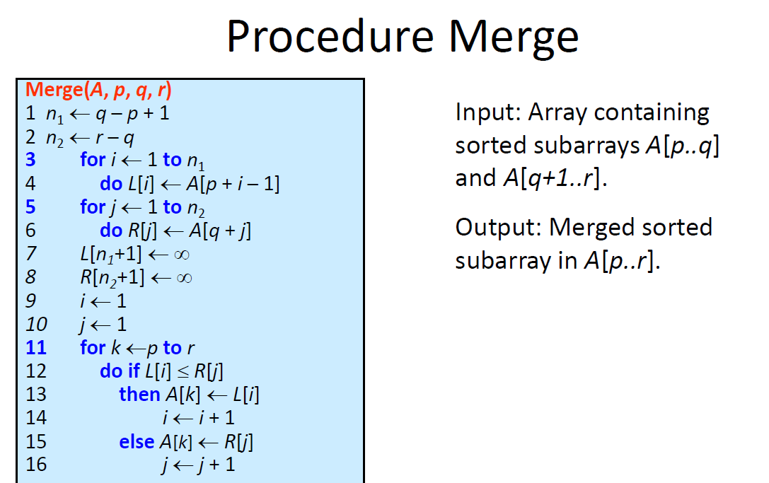

Slide 11
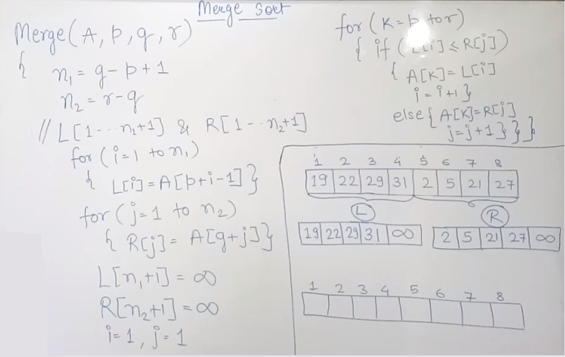

Slide 12
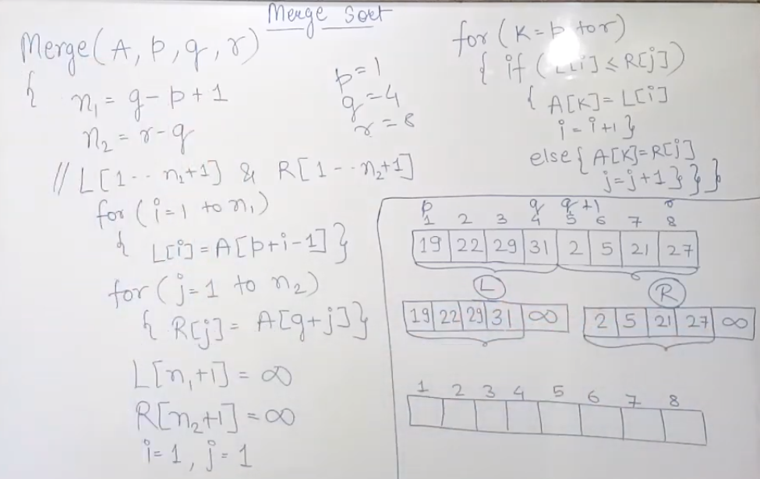

Slide 13
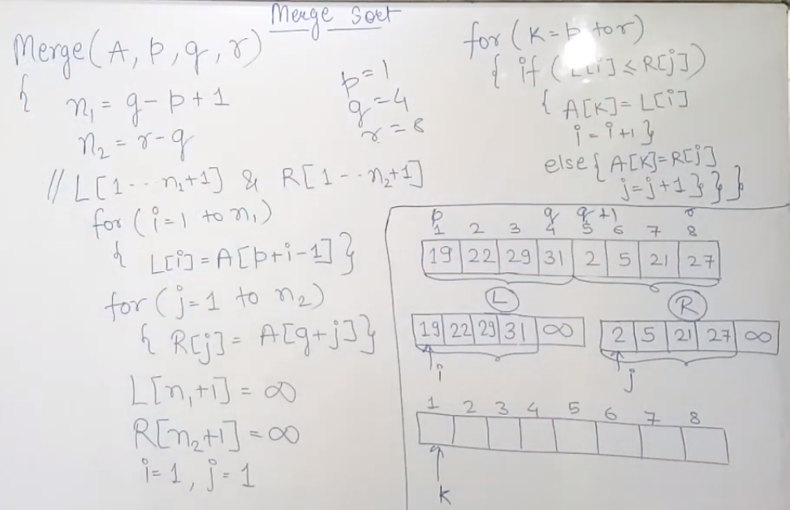

Slide 14
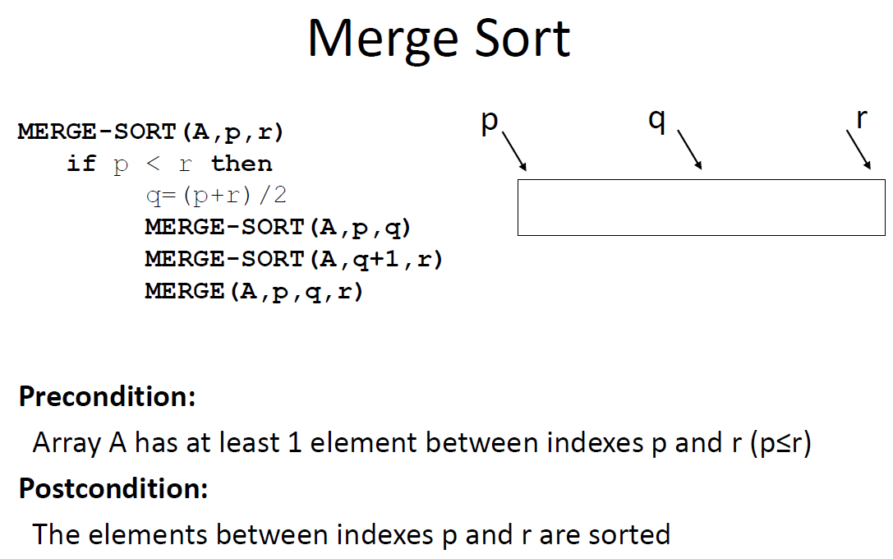
Starting by calling Merge-Sort(A,1,n)

Slide 15
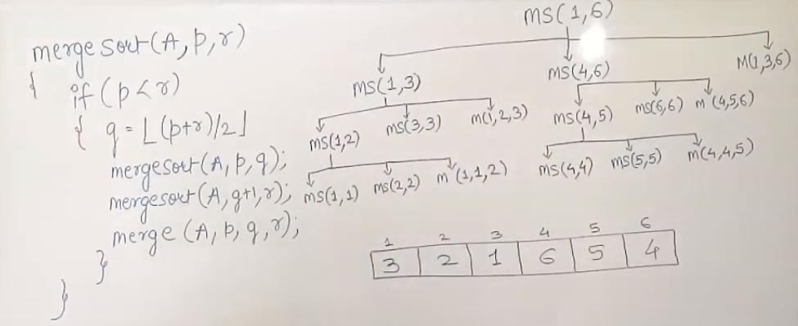
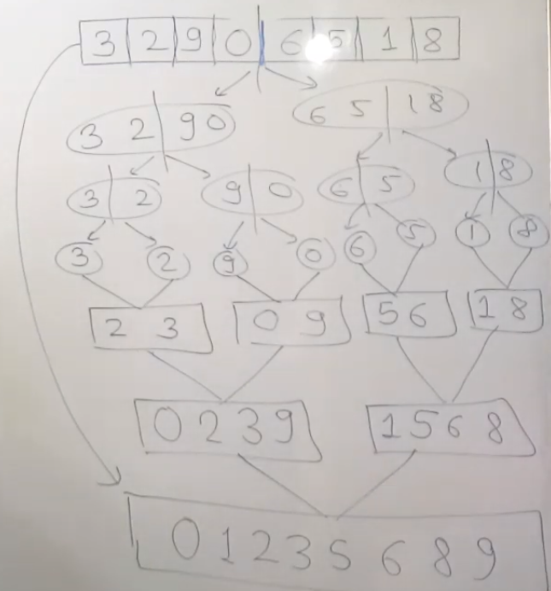
MERGE SORT FUNCTION CALLS

Slide 16
MERGE SORT FUNCTION CALLS

Slide 17
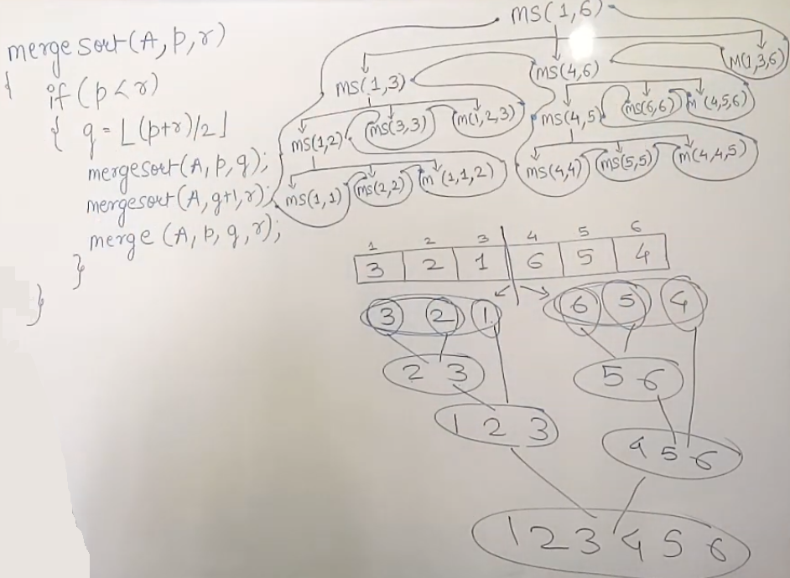
MERGE SORT FUNCTION CALLS

Slide 18
Correctness of MergeArray
Loop-invariant
At the start of each iteration of the for loop, the subarray A[1:k-1] contains the k-1 smallest elements of L[1:s+1] and R[1:t+1] in sorted order. Moreover, L[i] and R[j] are the smallest elements of their arrays that have not been copied back to A

Slide 19
Inductive Proof of Correctness
Initialization: (the invariant is true at beginning)
Prior to the first iteration of the loop, we have k = 1, so that A[1,k-1] is empty. This empty subarray contains k-1 = 0 smallest elements of L and R and since i = j = 1, L[i] and R[j] are the smallest element of their arrays that have not been copied back to A.

Slide 20
Inductive Proof of Correctness
Maintenance: (the invariant is true after each iteration)
assume L[i] <= R[j], the L[i] is the smallest element not yet copied back to A. Hence after copy L[i] to A[k], the subarray A[1..k] contains the k smallest elements. Increasing k and i by 1 reestablishes the loop invariant for the next iteration.

Slide 21
Inductive Proof of Correctness
Termination: (loop invariant implies correctness)
At termination we have k = s+t + 1, by the loop invariant, we have A contains the k-1 (s+t) smallest elements of L and R in sorted order.

Slide 22
Running Time of Merge-Sort
Running time as a function of the input size, that is the number of elements in the array A.
The Divide-and-Conquer scheme yields a clean recurrences.
Assume T(n) be the running time of merge-sort for sorting an array of n elements.
For simplicity assume n is a power of 2, that is, there exists k such that n = 2^{k} .

Slide 23
Recurrence of T(n)
T(1) = 1
for n > 1, we have
if n = 1
if n > 1

